Slide 1
Software Schedule Management
Generating Network Diagram

Slide 2
Project Scheduling
Split project into tasks and estimate time and resources required to complete each task
Organize tasks concurrently to make optimal use of workforce
Minimize task dependencies to avoid delays caused by one task waiting for another to complete
Dependent on project managers perceptions and experience

Slide 3
Scheduling problems
Estimating the difficulty of problems and hence the cost of developing a solution is hard
Productivity is not proportional to the number of people working on a task
Adding people to a late project makes it later because of communication overheads
The unexpected always happens. Always allow contingency in planning

Slide 4
Bar charts and activity networks
Graphical notations used to illustrate the project schedule
Show project breakdown into tasks. Tasks should not be too small. They should take about a week or two
Activity charts show task dependencies and the critical path
Bar charts show schedule against calendar time

Slide 5
Task Dependencies in Project Management
Dependencies are the relationships among tasks which determine the order in which activities need to be performed.
There are four (4) types of dependency relationships.

Slide 6
Task Dependencies in Project Management (Cont…)
Finish to Start
Predecessor must finish before Successor can start.
Start to Start
Predecessor must start before Successor can start.
Finish to Finish
Predecessor must finish before Successor can finish.
Start to Finish
Predecessor must start before Successor can finish.

Slide 7
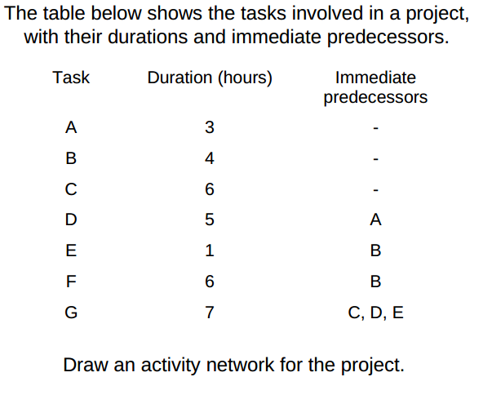
Task Durations And Dependencies

Slide 8
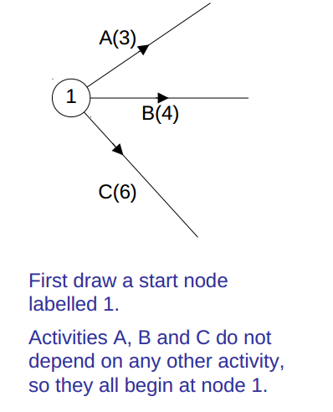
Activity Network

Slide 9
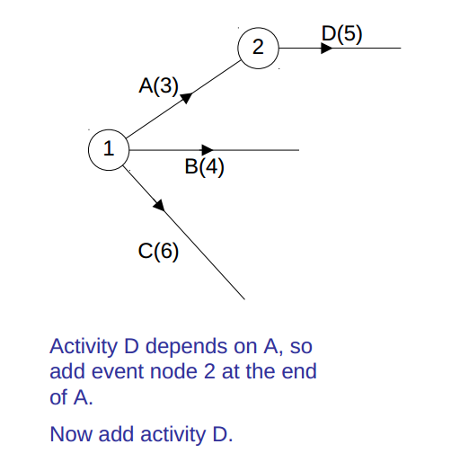

Slide 10
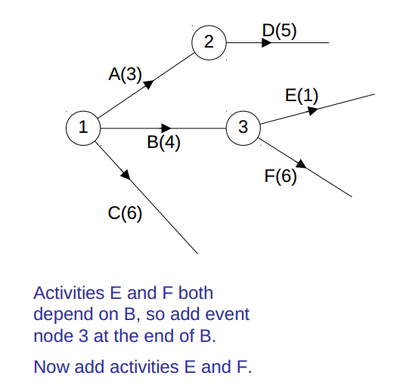

Slide 11
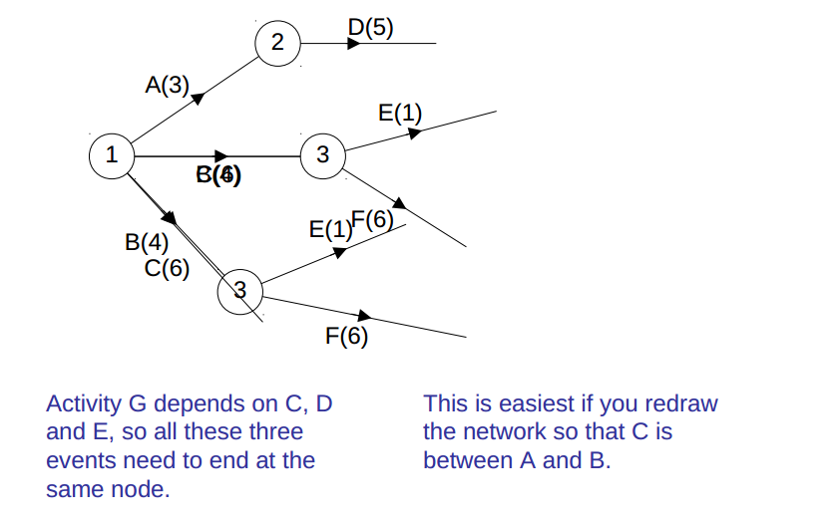

Slide 12
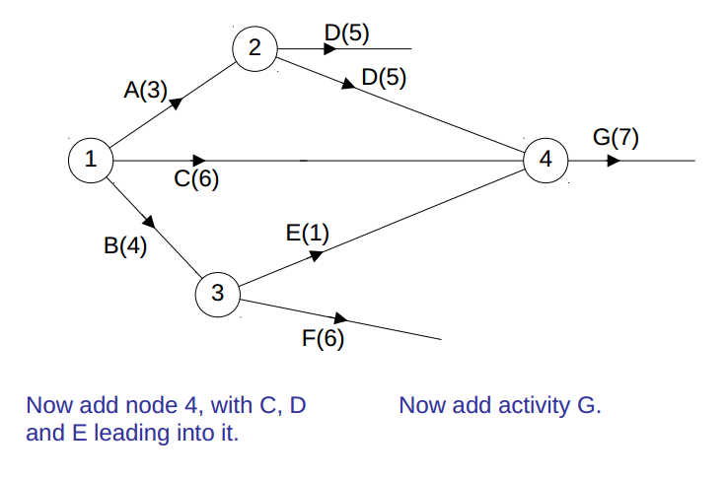

Slide 13
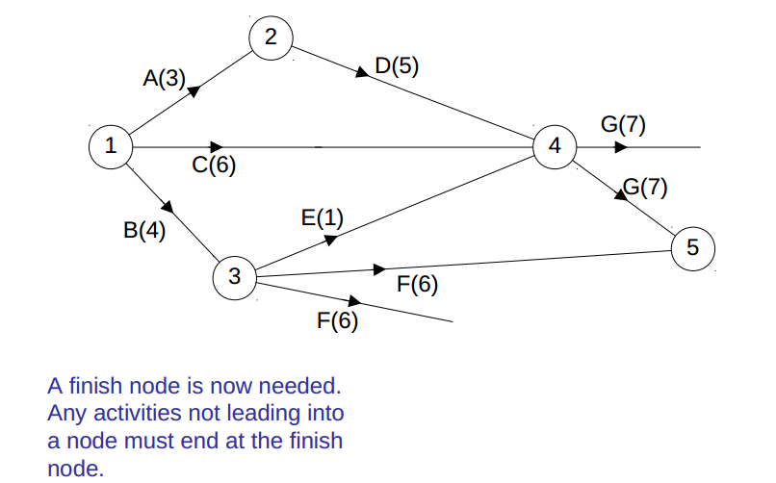

Slide 14
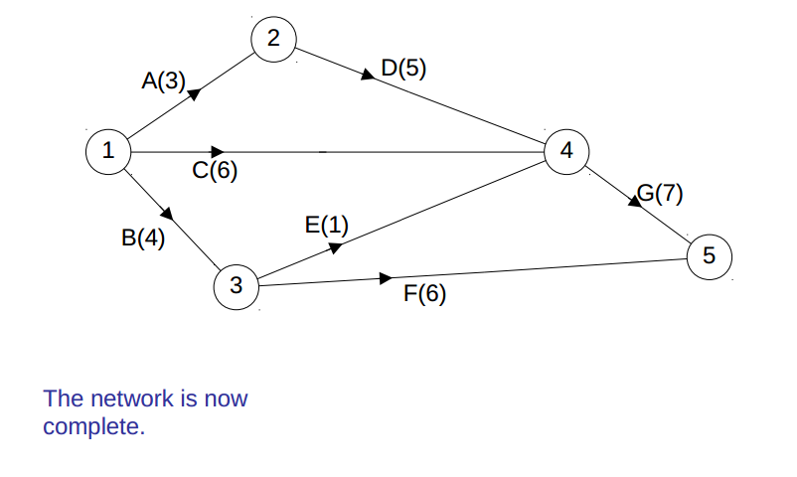

Slide 15
Key points
Good project management is essential for project success
The intangible nature of software causes problems for management
Managers have diverse roles but their most significant activities are planning, estimating and scheduling
Planning and estimating are iterative processes which continue throughout the course of a project

